Slide 1
Docker Overview
Application Frameworks (SE3040)
Vishan Jayasinghearachchi Lecturer
Department of Software Engineering, Faculty of Computing
vishan.j@sliit.lk

Slide 2
Contents
Docker Overview
What is Docker?
What does it do?
Docker use-case example
Docker Architecture
Docker Terminology
Hands-on demo

Slide 3
Docker Overview
What is Docker?
Docker is a platform that enables packaging and running an application in a loosely isolated environment called a container.
Docker enables you to separate your applications from your infrastructure.

Slide 4
Docker Overview
What does it do?
Docker provides tooling and a platform to manage the lifecycle of your containers:
Develop your application and its supporting components using containers.
The container becomes the unit for distributing and testing your application.
When you’re ready, deploy your application into your production environment, as a container or an orchestrated service.
This works the same whether your production environment is a local data center, a cloud provider, or a hybrid of the two.

Slide 5
Docker Overview
Docker use-case example
Your developers write code locally and share their work with their colleagues using Docker containers.
They use Docker to push their applications into a test environment and execute automated and manual tests.
When developers find bugs, they can fix them in the development environment and redeploy them to the test environment for testing and validation.
When testing is complete, getting the fix to the customer is as simple as pushing the updated image to the production environment.

Slide 6
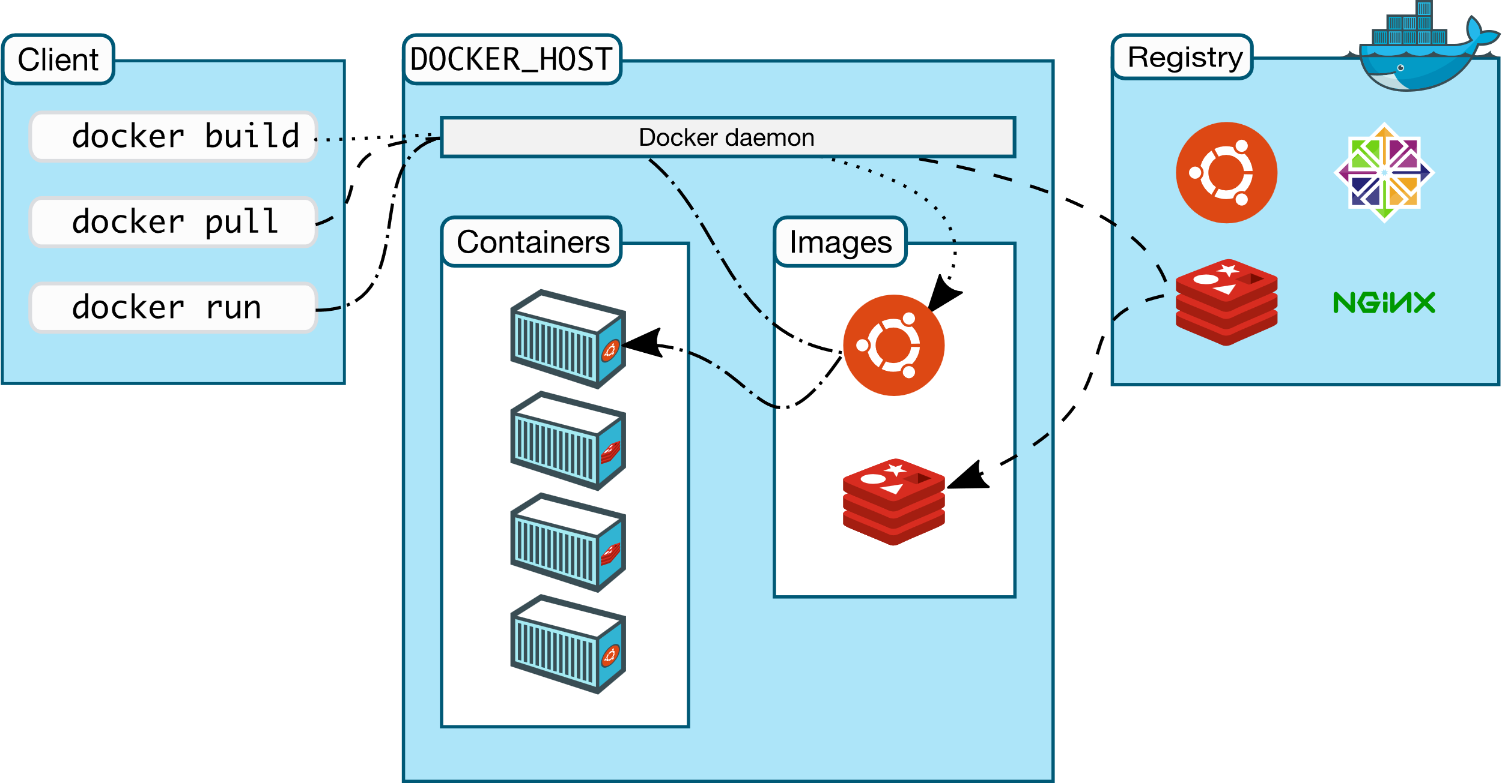
Docker Overview
Docker Architecture

Slide 7
Docker Overview
Docker Architecture
Has a Client-Server architecture.
Docker Client communicates with the Docker daemon which handles building and running of the containers.
Docker Registry is a repository of Docker Images.

Slide 8
Docker Overview
Docker Terminology
The Docker daemon - Manages Docker objects such as images, containers, networks, and volumes.
The Docker client – The program through which users interact with Docker.
Docker Desktop – The installation which include the daemon, client, compose, K8s etc.
Docker Registry - Stores Docker images. Default is Docker Hub.
Docker Objects
Image – A read-only template with instructions for creating a docker container.
Container – A runnable instance of an image.
Network – Facilitates communication among containers.
Volume - Provides the ability to connect specific filesystem paths of the container back to the host machine.
Plugin – Third-party extensions to enhance Docker’s capabilities.

Slide 9
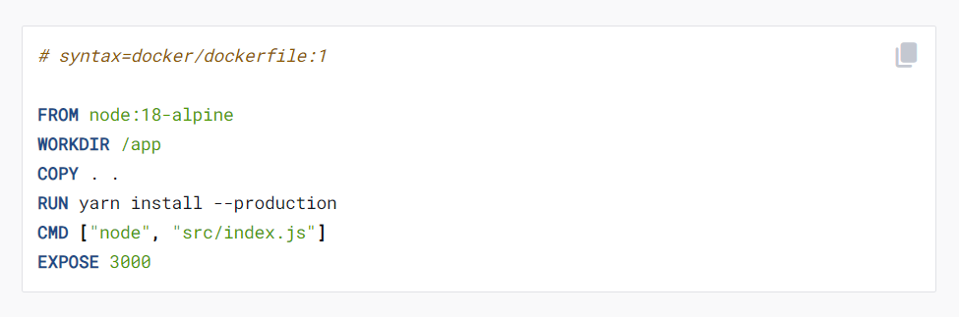
Build an image
Create a Dockerfile.
Source: https://docs.docker.com/get-started/02_our_app/

Slide 10
Build an image
Build the Docker Image.
docker build -t getting-started .
Create a container from the built Docker Image
docker run -dp 127.0.0.1:3000:3000 getting-started
Watch this video demo on building a Docker Image and creating a container using that.
The created image can be shared with others via a Container Registry such as the Docker Hub.

Slide 11
Multi-container apps
In general, a container should do one thing and do it well.
A real-world cloud native application based on Microservices will have multiple services implemented on multiple containers.
Docker Compose is a tool that can be used to define multi-container applications.
Watch this video tutorial on Docker Compose.
An Example

Slide 12
Self Study
Play with Docker is an interactive tool to learn Docker via your browser. Try it out.

Slide 13
Acknowledgements and Additional Reading
Docker overview

